Slide 1
DSTC7
2018. 10. 10
Shinhyung Kim, HyeongJoo Hwang

Slide 2
Contents
Dialog System Technology Challenge 7
Task description
Dataset
Baseline model
Model
Incorporating knowledge base
Memory network
Structure
Result

Slide 3
Dialog System Technology Challenge 7
Dialog System Technology Challenge
Sentence Selection
Sentence Generation
Audio Visual Scene-aware dialog (AVSD)
Sentence Selection Task: Two datasets are provided
Flex Data (Advising):
Student-Advisor dialogues for the purpose of guiding the student to pick courses that fit not only their curriculum, but also personal preferences about time, difficulty, career path, etc. Additional knowledge about courses and possible personal preferences will be provided.
Ubuntu Dialog Corpus (Ubuntu):
Disentangled Ubuntu IRC dialog. The purpose is to solve an Ubuntu user’s posted problem – two-party dialogues are provided. Additional knowledge will be provided in the form of manual pages.

Slide 4
Subtasks
Subtask | Evaluated on
 | Ubuntu dataset | Advising dataset
1. Select the next utterance from given candidate set | The set will contain between 1 option that is correct and 99 options that are incorrect (for a total of 100). | The set will contain between 1 option that is correct and 99 options that are incorrect (for a total of 100).
5. Subtask1 + External knowledge base(KB): Select the next utterance with a model which incorporate external knowledge | Subtask1 with KB; Ubuntu manual pages | Subtask1 with KB; Curriculum Database

Slide 5
Advising data
Example dialogue
S:Hello!
A :Hi!
S: I’m trying to decide what classes to take next semester. Any suggestions?
A: Give me a minute to look at your transcript. Can your preferences be told to me by you.
S: Of course! I am curious about Computer Science, video game design is something that has always been interesting for me.
A: For most computer science classes, Eecs 280 should be mandatory including game design.
S: Okay, I will accept that course. What advise you have on any other prerequisites for game design?
A: Eecs 281 is also necessary, and unfortunately you can't take both 280 and 281 in the same semester. You should take Eecs 203 since it's a prerequisite for most Eecs classes.
S: Okay, thanks for information. Are both EECS 203 and 280 based on projects?

Slide 6
Advising data
Example Candidate set
100 response candidates for each conversation
Anything more?
What degree programs are of interest to you?
Another more focused class is EECS 547, which explores the topic of Electronic Commerce
EECS492 is recommended.
Don't get fooled, 280 is all project based and 203 is not but many students say 203 is harder than 280.
According to your preference, I would suggest you to take EECS370.
I would recommend 492, Artificial Intelligence. I did grading for that class and the NLP we did every semester was really interesting.
Yes. They are EECS 370 and EECS 376.
That's great.
You probably want to combine 370 with 281 next semester.
Does that sound interesting to you?
…….

Slide 7
Advising data
Example profile
Standing: Sophomore
Term: WN 2008
Area: ['Software Development, Computing Infrastructure: 1', 'Computer Hardware: 1', 'Software Development: 2', 'Software Development, Computing Infrastructure, Web Technology & applications: 1']
ClarityRating: ['3: 4', '4: 6', '5: 1', '1: 1', '2: 3']
ClassSize: ['200.0: 1', '100.0: 7', '50.0: 5', '250.0: 1', '150.0: 1']
EasinessRating: ['3: 5', '4: 3', '1: 2', '2: 5']
FractionGreaterThanEqualToA: []
HelpfulnessRating: ['5: 1', '4: 4', '3: 6', '2: 4']
TimeOfDay: ['Morning: 25']
Workload: ['3: 2', '4: 1', '1: 1', '2: 7']
Prior courses:
ENGR101-FA-2006 / Ella Marie Atkins
MATH115-FA-2006 / Kristofer-Roy Gutierrez Reyes
CHEM130-FA-2006 / Vera Szabo
CHEM126-FA-2006 / Nancy Konigsberg Kerner
CHEM125-FA-2006 / Nancy Konigsberg Kerner
ENGR100-WN-2007 / NA
MATH116-WN-2007 / Ivan David Middleton
PHYSICS141-WN-2007 / Xuefei Li
PHYSICS140-WN-2007 / David Jerome Winn
Suggested courses:
EECS280-WN-2008 / Julia C Lipman
EECS203-WN-2008 / Mary Lou Dorf
EECS183-WN-2008 / Chandrasekhar Boyapati

Slide 8
Ubuntu data
Example dialogue
<User1> Hey guys, does your livecd have chroot installed? And bash?
<User2> sure
<User1> does it have everything I need to format a partition ext2?. And ext3?
<User2> yep
<User1> yay I can use it to install gentoo. !
<User2> lol. LOL
<User1> =-). Brb rebooting into ubuntu
<User2> form last week:. 04:41:47] <findme> this is a big crowd here. [04:21:53] <findme> have all Gentoo users moved here ?
<User1> to bad its still using apt I would switch in a heart beat if it had its own package manager

Slide 9
Ubuntu data
Example Candidate set
100 response candidates for each conversation
Issues with msn?. I’m experiencing them on windows atm, current msn version
Lspci will list your hareware, take a look at the VGA line
Beryll had that 3d cube effect
Export http_proxy=http://proxy:port export ftp_proxy=http://proxy:port
What laptop?
For what?
At least pixbuf and murine you can install right away
Your system logs will show errors maybe, so pastebin network manager problems.
Did you update before installing?
Do you have synaptic package manager open?
What are you missing in apt?

Slide 10
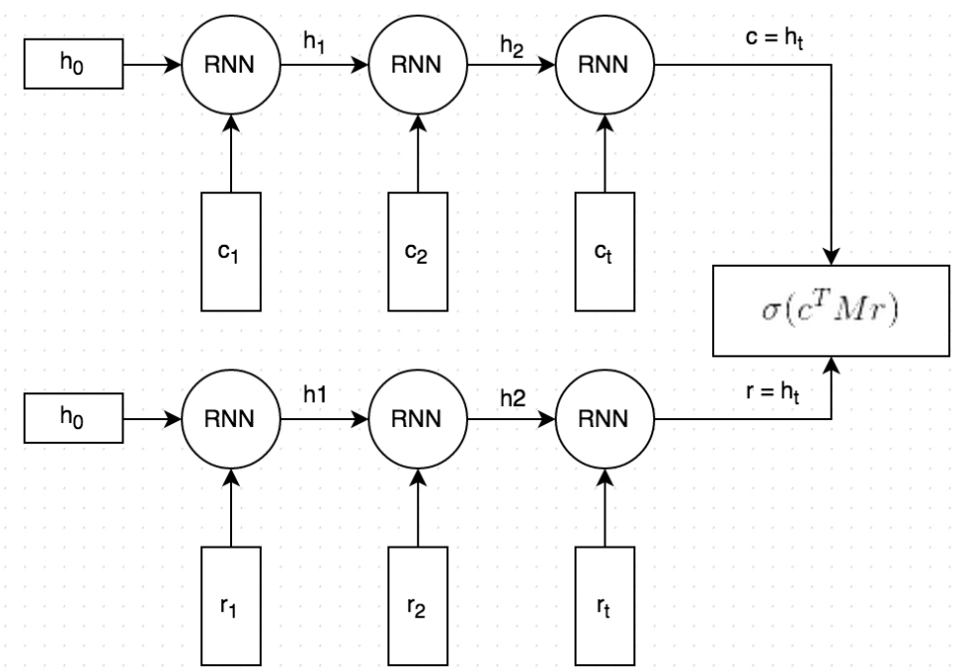
Baseline model: Dual Encoder
Structure of Dual Encoder
Dual Encoder Baselines (Recall)
conversation
probability
Softmax
100 responses
response
Dataset | 1 in 100 R@1 | 1 in 100 R@2 | 1 in 100 R@5 | 1 in 100 R@10 | 1 in 100 R@50
Ubuntu – Subtask1 | 8.32% | 13.36% | 24.26% | 35.98% | 80.04%
Advising – Subtask1 | 6.20% | 9.80% | 18.40% | 29.60% | 72.80%

Slide 11
Baseline: Dual Encoder
Details
Both the conversation and the response text are split by words, and each word is embedded into a vector. The word embeddings are initialized with Stanford’s GloVe vectors and are fine-tuned during training.
Both the embedded conversation and response are fed into the same Recurrent Neural Network word-by-word. The RNN generates a vector representation that, loosely speaking, captures the “meaning” of the conversation and response (c and r in the picture). We can choose how large these vectors should be, but let’s say we pick 256 dimensions.
We multiply c with a matrix M to “predict” a response r'. If c is a 256-dimensional vector, then M is a 256×256 dimensional matrix, and the result is another 256-dimensional vector, which we can interpret as a generated response. The matrix M is learned during training.
We measure the similarity of the predicted response r' and the actual response r by taking the dot product of these two vectors. A large dot product means the vectors are similar and that the response should receive a high score. We then apply a sigmoid function to convert that score into a probability. Note that steps 3 and 4 are combined in the figure.

Slide 12
External Knowledge
Advising data: Course description
Ex)
“EECS281-FA-2007”: {
“Area”: NA,
“Category”: “Core”,
“ClassSize”: 81.4,
“Course”: “EECS281”,
“CourseTitle”: “Data Structures and Algorithms”,
“Credits”: “4”,
“Description”: “Introduction to algorithm analysis and 0-notation; Fundamental data structures including lists, stacks, queues, priority queues, hash tables, binary trees, search trees, balanced trees and graphs; searching and sorting algorithms; recursive algorithms; basic graph algorithms; introduction to greedy algorithms and divide and conquer strategy. Several programming assignments.”,
“EasinessRating”: 2.53,
“HasDiscussion”: “Y”,
“HasLab”: “N”,
“HelpfulnessRating”: “FA”,
“Workload”: 3,
“Year”: 2007,
“section”: {
“Sugih Jamin”: {
“DaysofClass”: “”,
“EndTime”: “0:00:00”,
“StartTime”: “0:00:00”
}
}
}

Slide 13
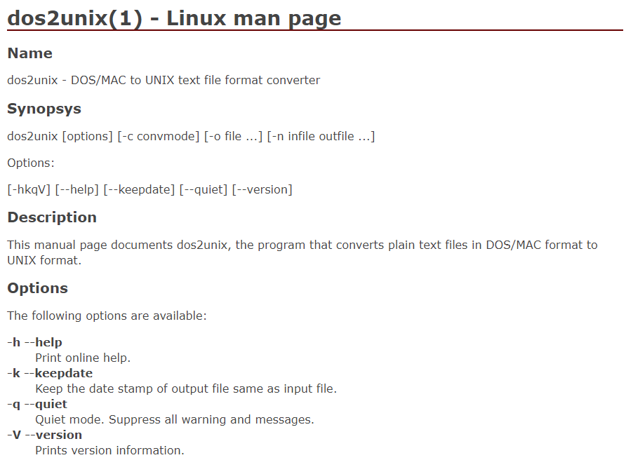
External Knowledge
Ubuntu data: Linux manual page of 10,000 commands
Ex)

Slide 14
Incorporating Knowledge Base
Problem: How to get certain knowledge from large unstructured textual data?
Solution: Make a hash table that can match certain keywords with its descriptions [1]
Entity hash table
Key(K): important entities that could appear in the conversation
Value(V): information corresponding to those entities
Relation hash table
Key(K): more common words that are related to the important entities
Value(V): entities from the entity table
[1] Lowe et al. “Incorporating Unstructured Textual Knowledged Sources into Neural Dialogue”, NIPS workshop on Machine Learning for Spoken Langugage Understanding 2015

Slide 15
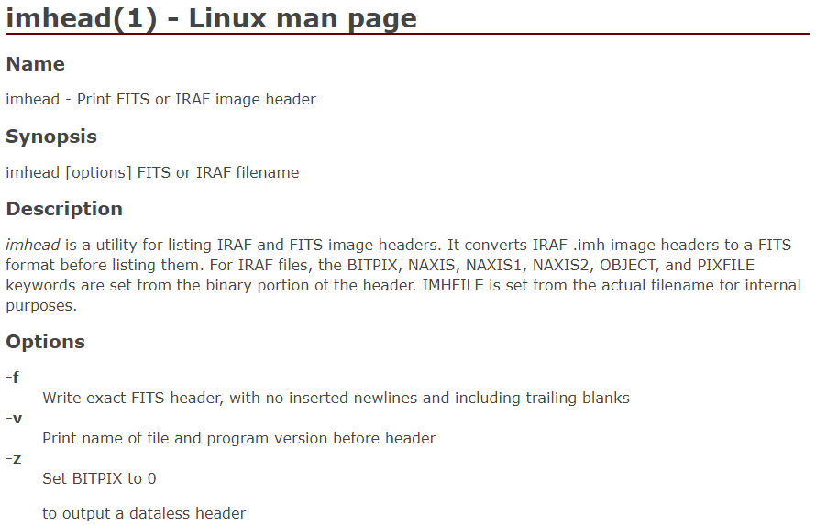
Incorporating Knowledge Base
Ex) Ubuntu manpage
Key for
entity hash table
Keys for relation hash table
Value for entity hash table
Entity hash table
K: “imhead”
V: “imhead is a utility for listing IRAF and FITS image headers.……”
Relation hash table
K: “Print”, “FITS”, “or”, “IRAF”, “image”, “header”
V: “imhead”

Slide 16
Incorporating Knowledge Base
Ex) Course information
“EECS281-FA-2007”: {
“Area”: NA,
“Category”: “Core”,
“ClassSize”: 81.4,
“Course”: “EECS281”,
“CourseTitle”: “Data Structures and Algorithms”,
“Credits”: “4”,
“Description”: “Introduction to algorithm analysis and 0-notation; Fundamental data structures including lists, stacks, queues, priority queues, hash tables, binary trees, search trees, balanced trees and graphs; searching and sorting algorithms; recursive algorithms; basic graph algorithms; introduction to greedy algorithms and divide and conquer strategy. Several programming assignments.”,
“EasinessRating”: 2.53,
“HasDiscussion”: “Y”,
“HasLab”: “N”,
“HelpfulnessRating”: “FA”,
“Workload”: 3,
“Year”: 2007,
“section”: {
“Sugih Jamin”: {
“DaysofClass”: “”,
“EndTime”: “0:00:00”,
“StartTime”: “0:00:00”
}
}
}
Key for entity hash table
Each word become Keys for relation hash table
Value for entity hash table
Entity hash table
K: “EECS281”
V: “Introduction to algorithm analysis and 0-notation……..”
Relation hash table
K: “Data”, “Structures”, “and”, “Algorithms”
V: “EECS281”

Slide 17
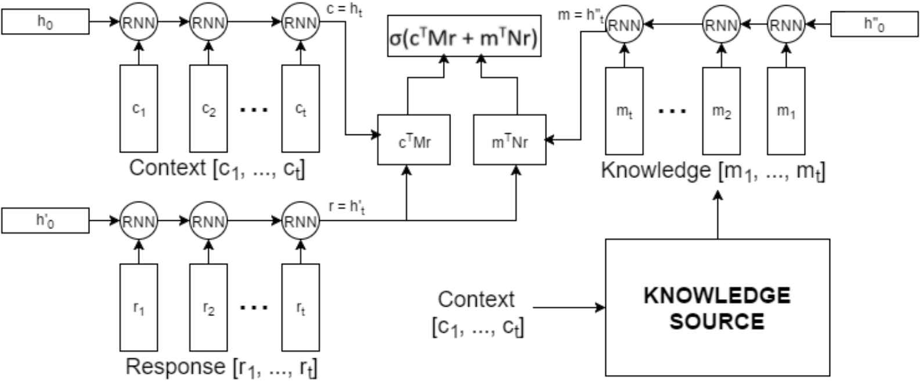
Incorporating Knowledge Base
Basic model for incorporating knowledge base: Tri-encoder
Drawbacks of Dual-encoder, Tri-encoder
Encoding whole conversation into one fixed-length vector regardless of the size of the conversation
Indirect comparison between conversation-knowledge and response-knowledge

Slide 18
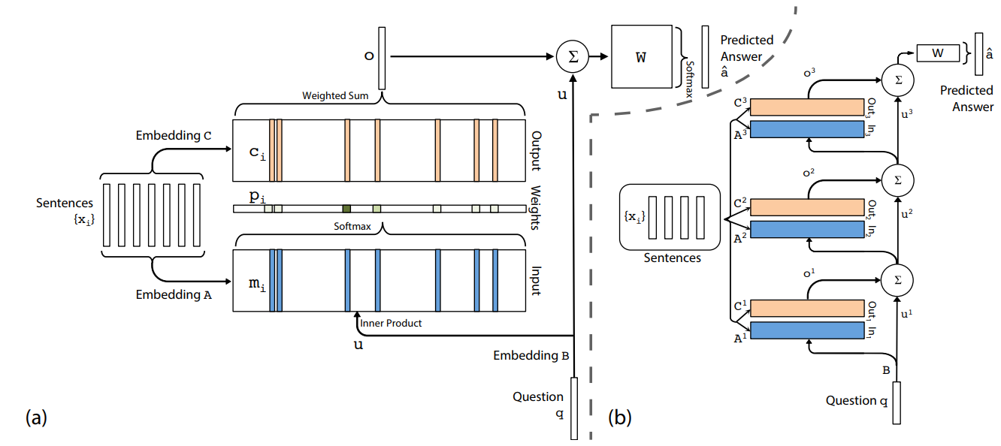
Memory Network
Basic Architecture
Embedding matrices A, B, C are learned during training
Increasing hops improves performance

Slide 19
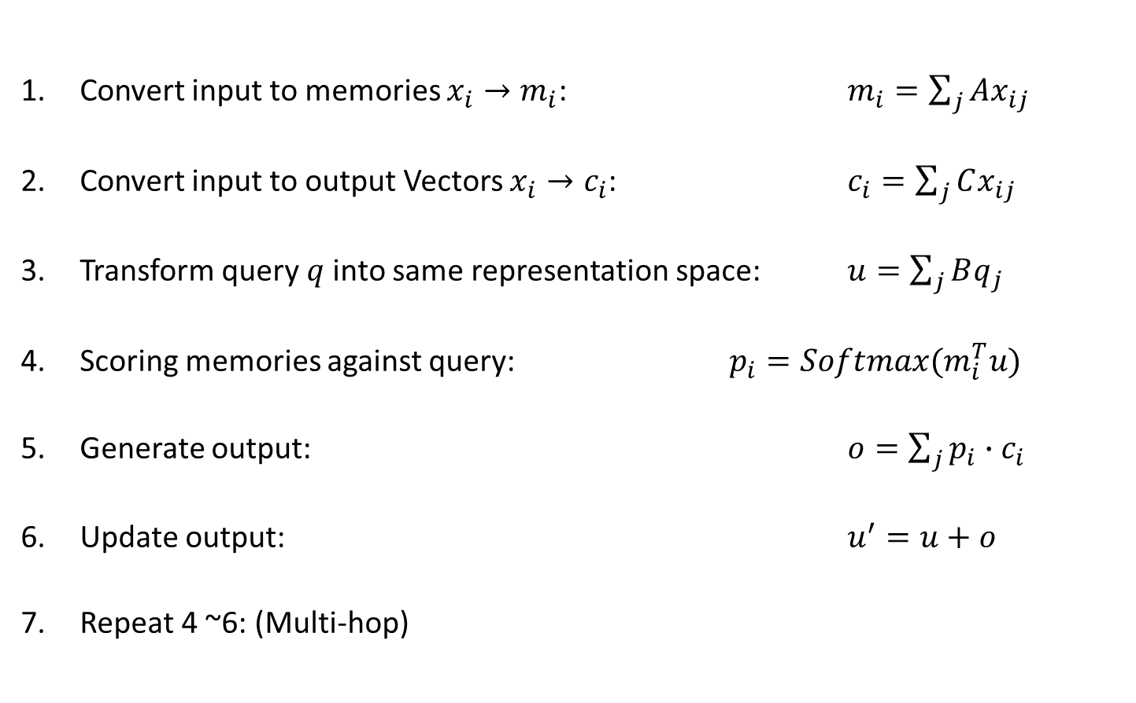
Memory Network (not necessary)
Convert input to memories $x_{i}→m_{i}$: $m_{i}=\sum_{j}{Ax_{ij}}$
Convert input to output Vectors $x_{i}→c_{i}$: $c_{i}=\sum_{j}{Cx_{ij}}$
Transform query$q$ into same representation space: $u=\sum_{j}{Bq_{j}}$
Scoring memories against query: $p_{i}=Softmax(m_{i}^{T}u)$
Generate output: $o=\sum_{j}{p_{i}∙c_{i}}$
Update output: $u^{′}=u+o$
Repeat 4 ~6: (Multi-hop)

Slide 20
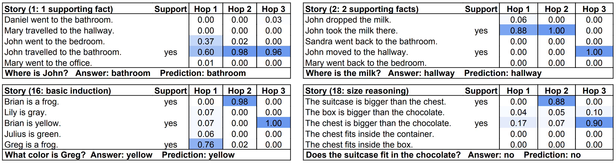
Multi-hop End-to-End Memory Network

Slide 21
Memory Network (not necessary)
Advantages of Memory Network
Non-decaying memory
Two different memory representation with different function
Multi-hop helps with augmenting all relevant information
Disadvantages of Memroy Network
Embedding matrices A and C are too weakly supervised
Input of A and C are exactly the same.
No guarantee that A and C are learned according to their roles.
Naïve sentence encoding
Encoding based on Bag of Words
Encode sentences separately

Slide 22
Bidirectional Context-Encoded Memory Network
Similarity score
Attention generated by similarity
between conversation and (augmented) response
Attention generated within a conversation
Weighted
conversation
Dot
Augmented
Response
∙∙∙
Dense
LSTM A
(Backward)
∙∙∙
Add
∙∙∙
∙∙∙
Add
Add
conversation
(embedded)
Add
∙∙∙
Dense
LSTM A
(Forward)
∙∙∙
Add
LSTM B
Two arrows into one tensor means multiplication
Response
(embedded)

Slide 23
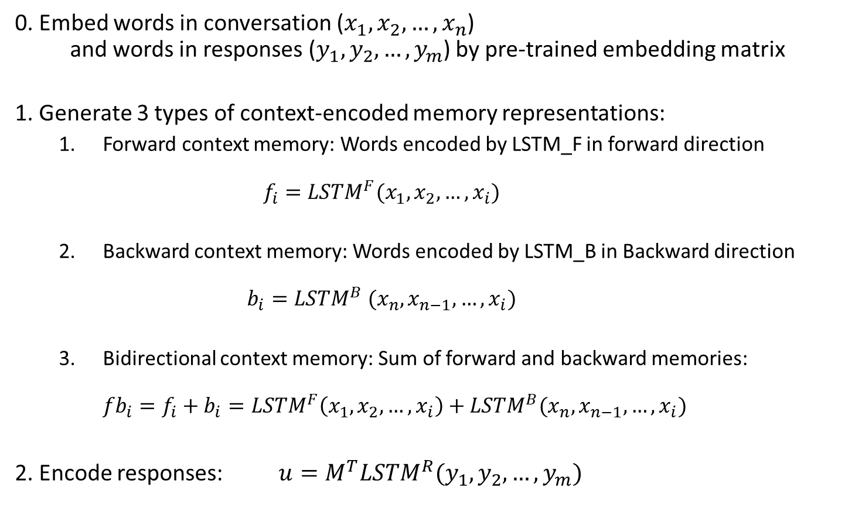
BCEMN
0. Embed words in conversation ($x_{1}, x_{2}, …, x_{n}$) and words in responses ($y_{1},y_{2},…,y_{m}$) by pre-trained embedding matrix
1. Generate 3 types of context-encoded memory representations:
Forward context memory: Words encoded by LSTM_F in forward direction $f_{i}=LSTM^{F}(x_{1}, x_{2}, …, x_{i})$
Backward context memory: Words encoded by LSTM_B in Backward direction $b_{i}=LSTM^{B} (x_{n}, x_{n−1}, …, x_{i})$
Bidirectional context memory: Sum of forward and backward memories: ${fb}_{i}=f_{i}+b_{i}=LSTM^{F}\left(x_{1}, x_{2}, …, x_{i}\right)+LSTM^{B}(x_{n}, x_{n−1}, …, x_{i})$
2. Encode responses: $u=M^{T}LSTM^{R}(y_{1},y_{2},…,y_{m})$
Eq.1
Eq.2
Eq.3
Eq.4

Slide 24
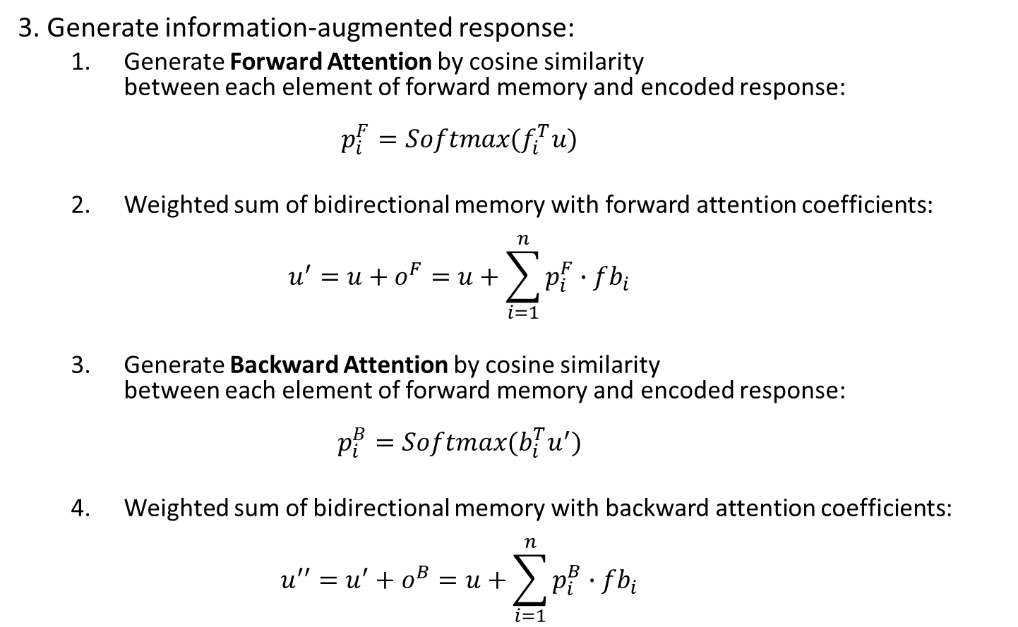
BCEMN
3. Generate information-augmented response:
Generate Forward Attention by cosine similarity between each element of forward memory and encoded response: $p_{i}^{F}=Softmax(f_{i}^{T}u)$
Weighted sum of bidirectional memory with forward attention coefficients: $u^{′}=u+o^{F}=u+\sum_{i=1}^{n}{p_{i}^{F}}∙fb_{i}$
Generate Backward Attention by cosine similarity between each element of forward memory and encoded response: $p_{i}^{B}=Softmax(b_{i}^{T}u^{′})$
Weighted sum of bidirectional memory with backward attention coefficients: $u^{′′}=u^{′}+o^{B}=u+\sum_{i=1}^{n}{p_{i}^{B}}∙fb_{i}$
Eq.5
Eq.6
Eq.7
Eq.8

Slide 25
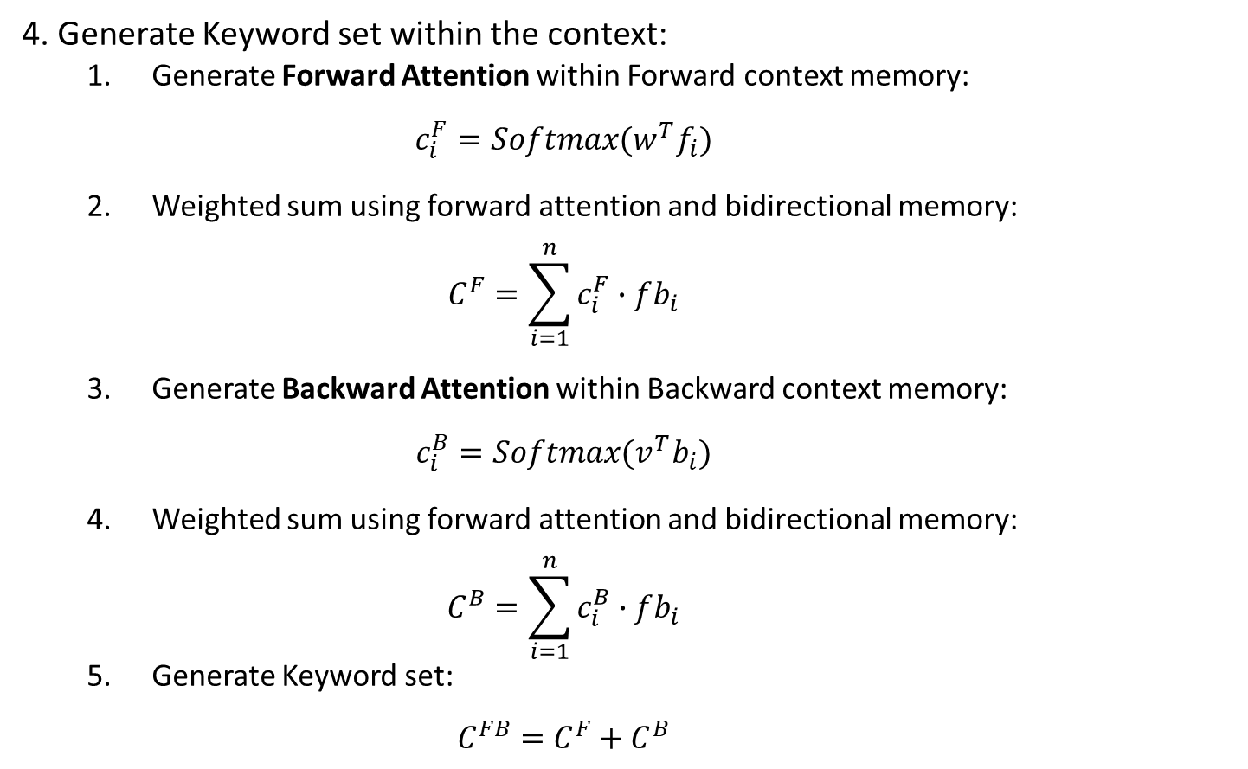
BCEMN
4. Generate Keyword set within the context:
Generate Forward Attention within Forward context memory: $c_{i}^{F}=Softmax(w^{T}f_{i})$
Weighted sum using forward attention and bidirectional memory: $C^{F}=\sum_{i=1}^{n}{c_{i}^{F}∙fb_{i}}$
Generate Backward Attention within Backward context memory: $c_{i}^{B}=Softmax(v^{T}b_{i})$
Weighted sum using forward attention and bidirectional memory: $C^{B}=\sum_{i=1}^{n}{c_{i}^{B}∙fb_{i}}$
Generate Keyword set: $C^{FB}=C^{F}+C^{B}$
Eq.9
Eq.10
Eq.11
Eq.12
Eq.13

Slide 26
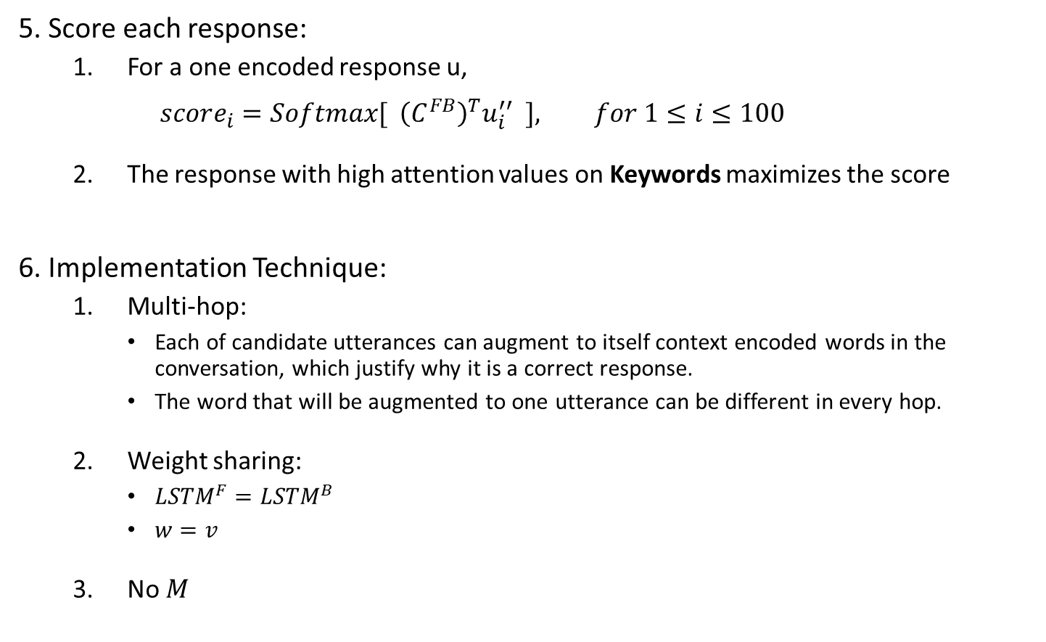
BCEMN
5. Score each response:
For a one encoded response u, $score_{i}=Softmax[ {\left(C^{FB}\right)}^{T}u_{i}^{′′} ], for 1≤i≤100$
The response with high attention values on Keywords maximizes the score
6. Implementation Technique:
Multi-hop:
Each of candidate utterances can augment to itself context encoded words in the conversation, which justify why it is a correct response.
The word that will be augmented to one utterance can be different in every hop.
Weight sharing:
${LSTM}^{F}={LSTM}^{B}$
$w=v$
No $M$
Eq.14

Slide 27
Model characteristics
Bidirectional context encoded word representation by LSTM
Bidirectional LSTM encoders to encode every word in the conversation with forward, backward, and bidirectional context.
Encoded words comprise three non-decaying memories
Sentence-to-word level Attention and multi hop
Each candidate response reads conversation back and forth multiple times => Finds and augments context-encoded keyword that is relevant to itself
Each candidate may augment different word in every hop
Figure out Keywords in the Conversation
Applicable to the data with external knowledge

Slide 28
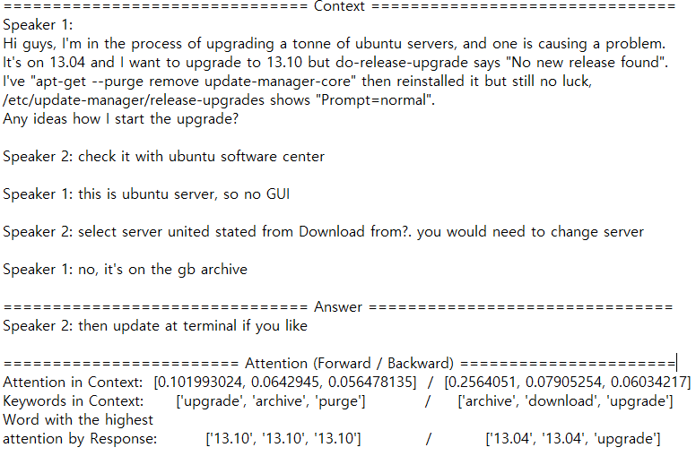
Example 1

Slide 29
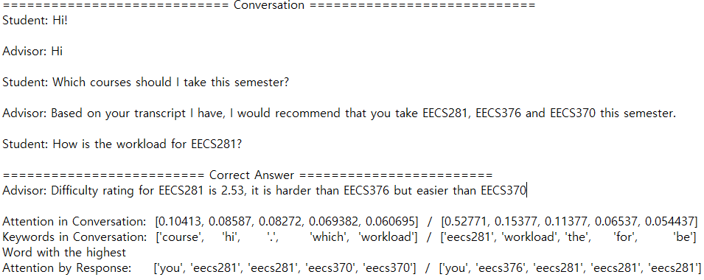
Example 2

Slide 30
BCEMN with KB
Similarity score
Dot
Evaluate KB &
Weighted sum
Weighted
conversation
Augmented
KB
Augmented
Response
Dense
b
LSTM B
b
Add
∙∙∙
∙∙∙
fb
∙∙∙
∙∙∙
fb
Add
Add
conversation
(embedded)
Add
Dense
f
LSTM F
f
Add
∙∙∙
∙∙∙
Inner product
LSTM K LSTM R
Two arrows into one tensor means multiplication
KB
(embedded)
Response
(embedded)

Slide 31
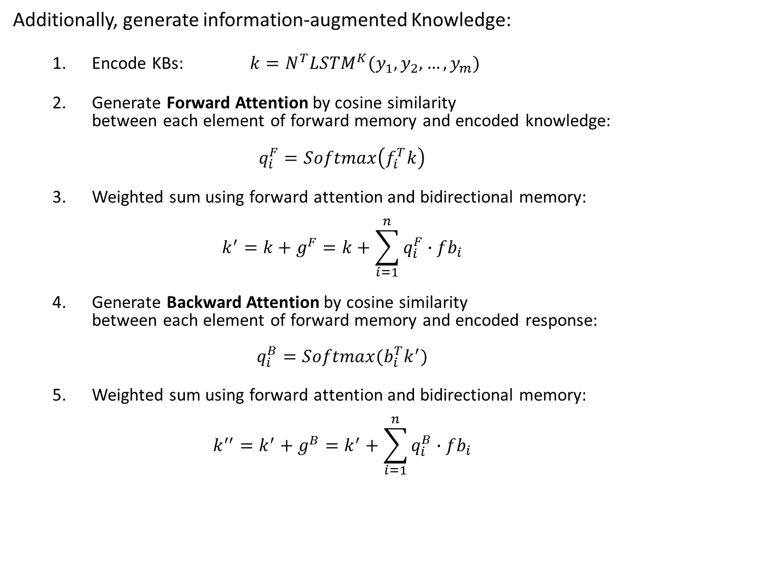
BCEMN with External Knowledge
Additionally, generate information-augmented Knowledge:
Encode KBs: $k=N^{T}LSTM^{K}(y_{1},y_{2},…,y_{m})$
Generate Forward Attention by cosine similarity between each element of forward memory and encoded knowledge: $q_{i}^{F}=Softmax\left(f_{i}^{T}k\right)$
Weighted sum using forward attention and bidirectional memory: $k^{′}=k+g^{F}=k+\sum_{i=1}^{n}{q_{i}^{F}∙fb_{i}}$
Generate Backward Attention by cosine similarity between each element of forward memory and encoded response: $q_{i}^{B}=Softmax(b_{i}^{T}k^{′})$
Weighted sum using forward attention and bidirectional memory: $k^{′′}=k^{′}+g^{B}=k^{′}+\sum_{i=1}^{n}{q_{i}^{B}∙fb_{i}}$
Eq.15
Eq.16
Eq.16
Eq.17
Eq.18

Slide 32
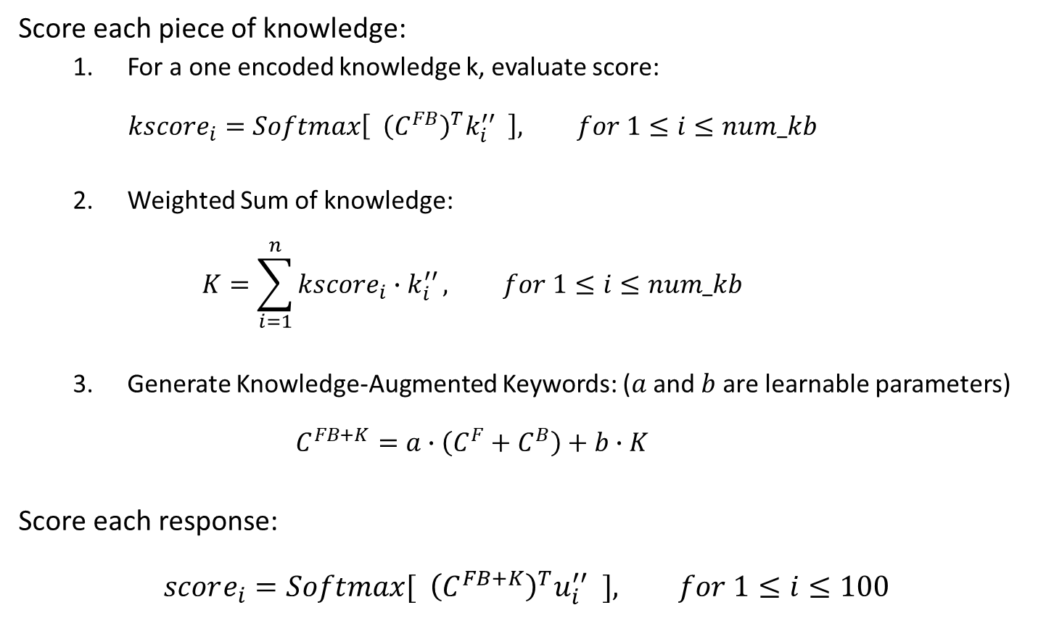
BCEMN with External Knowledge
Score each piece of knowledge:
For a one encoded knowledge k, evaluate score: $kscore_{i}=Softmax\left[ {\left(C^{FB}\right)}^{T}k_{i}^{′′} \right], for 1≤i≤num_kb$
Weighted Sum of knowledge: $K=\sum_{i=1}^{n}{kscore_{i}∙k_{i}^{′′}}, for 1≤i≤num_kb$
Generate Knowledge-Augmented Keywords: ($a$ and $b$ are learnable parameters) $C^{FB+K}=a∙\left(C^{F}+C^{B}\right)+b∙K$
Score each response: $$score_{i}=Softmax[ {\left(C^{FB+K}\right)}^{T}u_{i}^{′′} ], for 1≤i≤100$$
Eq.19
Eq.20
Eq.21
Eq.22

Slide 33
Results
Dataset | Task | Accuracy
 |  | Top 1 | Top 2 | Top 5 | Top 10 | Top 50
Advising | Baseline | 6.20% | 9.80% | 18.40% | 29.60% | 72.80%
 | Task1 | 10.60% | 18.00% | 29.20% | 42.20% | 81.80%
 | Task2 | 10.80% | 15.40% | 25.60% | 39.20% | 80.80%
Ubuntu | Baseline | 8.32% | 13.36% | 24.26% | 35.98% | 80.04%
 | Task1 | 20.36% | 28.94% | 41.54% | 53.40% | 85.82%
 | Task2 | 20.28% | 29.80% | 42.84% | 53.88% | 88.64%

